Slide 1


Tiago Amador Coelho
01/01/2024

Slide 2

Outline
Executive Summary
Introduction
Methodology
Results
Conclusion
Appendix

Slide 3
Executive Summary
Summary of methodologies
Collecting the Data on the Falcon 9 first-stage landings
Data Wrangling
Exploratory Analysis Using SQL
Visual analytics and dashboard to analyze launch records interactively
Create Models to determine if the first stage of Falcon 9 will land successfully
Summary of all results
Launch success has improved over time
Space X Falcon 9 First Stage Landing predict

Slide 4
Introduction
Background and context
SpaceX is an aerospace company founded in 2002 that stands out worldwide in space transportation services. Its success is due to the Falcon 9 rockets, in which Space X can reuse its first stage. Other companies have a cost of 165 million dollars for each rocket launched, but because Space X can reunite the first stage of the Falcon 9, the cost of launching each rocket is 62 million dollars.
Problem to answer
It is possible to predict Space X Falcon 9 First Stage Landing?

Slide 5

Section 1

Slide 6
Methodology
Executive Summary
Data collection methodology:
Describe how data was collected
Perform data wrangling
Describe how data was processed
Perform exploratory data analysis (EDA) using visualization and SQL
Perform interactive visual analytics using Folium and Plotly Dash
Perform predictive analysis using classification models
How to build, tune, evaluate classification models

Slide 7
Data Collection
Request and parse the SpaceX launch data
Filter the dataframe to only include `Falcon 9` launches
Dealing with Missing Values
Export it to a CSV
SpaceX REST API
Request the Falcon9 Launch Wiki page from its URL
Extract all column/variable names from the HTML table header
Create a data frame by parsing the launch HTML tables
Export it to a CSV
Web scraping Wikipedia

Slide 8
Data Collection – SpaceX API
Request and parse the SpaceX launch data using the GET request
Decode the response content as a Json and convert to a dataframe
Request information about the launches from SpaceX API using custom functions
Create dictionary from the data
Create dataframe from the dictionary
Filter dataframe to contain only Falcon 9 launches
Replace missing values of Payload Mass with mean value of Payload Mass
Export data to csv file
Steps
Request and parse the SpaceX launch data using the GET request
Decode the response content as a Json and convert to a dataframe
Request information about the launches from SpaceX API using custom functions
Create dictionary from the data
Create dataframe from the dictionary
Filter dataframe to contain only Falcon 9 launches
Replace missing values of Payload Mass with mean value of Payload Mass
Export data to csv file
https://github.com/tiagoamador/IBM_Data_Science_Capstone/blob/main/jupyter-labs-spacex-data-collection-api.ipynb

Slide 9
Data Collection - Scraping
Request the Falcon9 Launch Wiki page
Create a BeautifulSoup object from a response text content
Extract column names from HTML table header
Collect data from parsing HTML tables
Create dictionary from the data
Create dataframe from the dictionary
Export data to csv file
Steps
Request the Falcon9 Launch Wiki page
Create a BeautifulSoup object from a response text content
Extract column names from HTML table header
Collect data from parsing HTML tables
Create dictionary from the data
Create dataframe from the dictionary
Export data to csv file
https://github.com/tiagoamador/IBM_Data_Science_Capstone/blob/main/jupyter-labs-webscraping.ipynb

Slide 10
Data Wrangling
Load Space X dataset
Calculate the number of launches on each site
Calculate the number and occurrence of each orbit
Calculate the number and occurence of mission outcome of the orbits
Create a landing outcome label
Calculate the success rate
Export data to csv file
Steps
Load Space X dataset
Calculate the number of launches on each site
Calculate the number and occurrence of each orbit
Calculate the number and occurence of mission outcome of the orbits
Create a landing outcome label
Calculate the success rate
Export data to csv file
https://github.com/tiagoamador/IBM_Data_Science_Capstone/blob/main/labs-jupyter-spacex-Data%20wrangling.ipynb

Slide 11
EDA with Data Visualization
Some charts were chosen to analyze data to summarize main characteristics, gain a better understanding of the data set, uncover relationships between different variables, and extract important variables for the problem
Flight Number vs Pay Load Mass
Flight Number vs Launch Site
Pay Load Mass vs Launch Site
Orbit Type vs Success Rate
Flight Number vs Orbit
Pay Load Mass vs Orbit
Date vs Class
Year vs Success Rate
https://github.com/tiagoamador/IBM_Data_Science_Capstone/blob/main/jupyter-labs-eda-dataviz.ipynb.jupyterlite.ipynb

Slide 12
EDA with SQL
Queries
Display
Display the names of the unique launch sites in the space mission
Display 5 records where launch sites begin with the string 'CCA'
Display the total payload mass carried by boosters launched by NASA (CRS)
Display average payload mass carried by booster version F9 v1.1
List:
List the date when the first succesful landing outcome in ground pad was acheived.
List the names of the boosters which have success in drone ship and have payload mass greater than 4000 but less than 6000
List the total number of successful and failure mission outcomes
List the names of the booster_versions which have carried the maximum payload mass
List the records which will display the month names, failure landing_outcomes in drone ship, booster versions, launch_site for the months in year 2015.
Rank the count of landing outcomes (such as Failure (drone ship) or Success (ground pad)) between the date 2010-06-04 and 2017-03-20, in descending order.
https://github.com/tiagoamador/IBM_Data_Science_Capstone/blob/main/jupyter-labs-eda-sql-coursera_sqllite.ipynb

Slide 13
Build an Interactive Map with Folium
Create a blue circle at NASA Johnson Space Center's coordinate
For each launch site, add a Circle object based on its coordinate (Lat, Long) values
Mark the success(green)/failed(red) launches for each site on the map
Calculate the distances between a launch site to its proximities (city, railway, highway)
Add the GitHub URL of your completed interactive map with Folium map, as an external reference and peer-review purpose
https://github.com/tiagoamador/IBM_Data_Science_Capstone/blob/main/lab_jupyter_launch_site_location.jupyterlite.ipynb

Slide 14
Build a Dashboard with Plotly Dash
A dropdown list to enable Launch Site selection
A pie chart to show the total successful launches
A slider to select payload range
A scatter chart to show the correlation between payload and launch success
https://github.com/tiagoamador/IBM_Data_Science_Capstone/blob/main/spacex_dash_app.py

Slide 15
Predictive Analysis
Load Space X Data from Data Base.
Create a NumPy array from the column Class in data.
Preprocess the data with StandardScaler(), fit and transform it.
Split the data into training and test data.
Create a GridSearchCV with cv = 10.
Apply GridSearchCV on different algorithms: logistic regression, SVC, decision tree, KNN.
Calculate the accuracy from all models on the test data.
Identify the best model using accuracy.
https://github.com/tiagoamador/IBM_Data_Science_Capstone/blob/main/SpaceX_Machine_Learning_Prediction_Part_5.jupyterlite.ipynb
Load Data
Create a NumPy array from the column Class in data
Standardize the data
Split the data into training and test data
Create a GridSearchCV with cv = 10
Apply GridSearchCV on different algorithms:
Calculate the accuracy on the test data
Identify the best model

Slide 16
Results
Exploratory data analysis results
Interactive analytics demo in screenshots
Predictive analysis results

Slide 17

Section 2

Slide 18
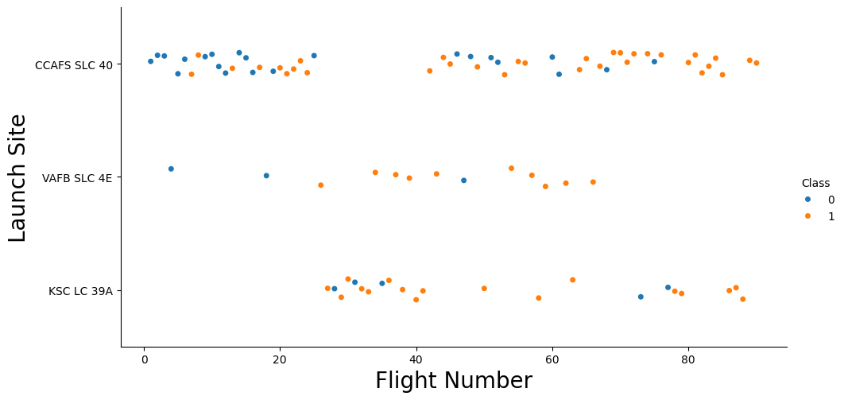
Flight Number vs. Launch Site
Class 0 (blue) = fail
Class 1 (orange) = success
New launches have a higher success rate

Slide 19
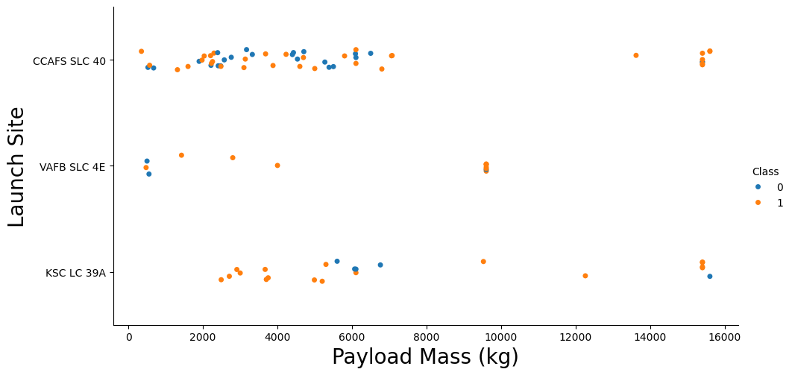
Payload vs. Launch Site
Rockets with a payload greater than 7000 have a better chance of success

Slide 20
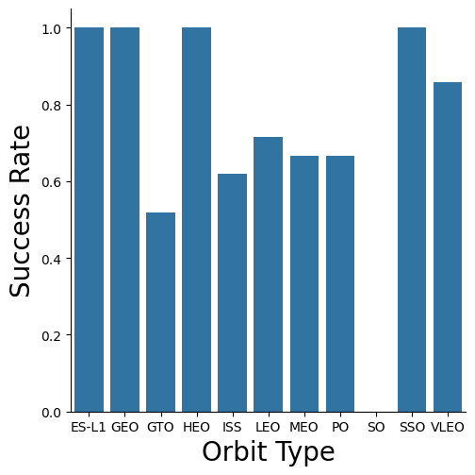
Success Rate vs. Orbit Type
There are 4 orbits in which all launches were successful
There is 1 orbit that was not successfully launched

Slide 21
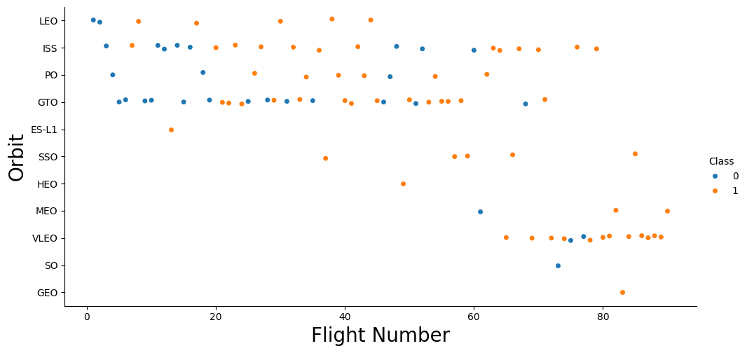
Flight Number vs. Orbit Type
In the first 6 launches there was fail
The fail rate decrease with the number of flights

Slide 22
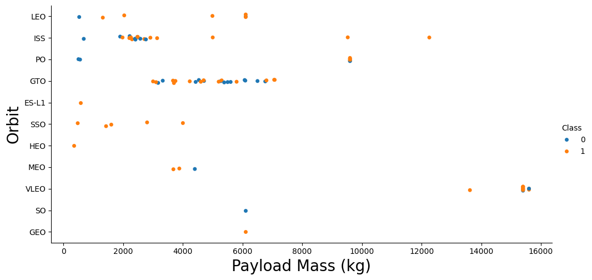
Payload vs. Orbit Type
Orbits that were not used with a payload greater than 8000:
LEO, ES-L1, GTO, SSO, HEO, MEO, SO, GEO

Slide 23
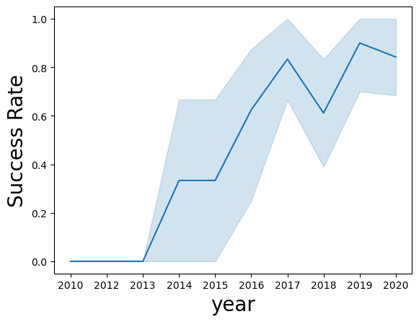
Launch Success Yearly Trend
The success rate has been on a growth trend since 2013, with small declines in 2017 and 2020

Slide 24
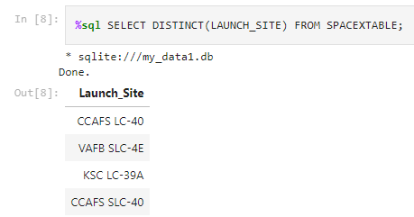
All Launch Site Names
Launch sites names
CCAFS LC-40
VAFB SLC-4E
KSC LC-39A
CCAFS SLC-40

Slide 25
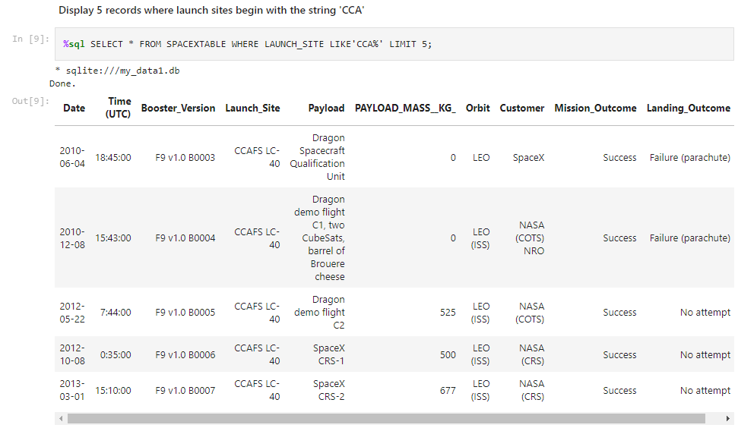
Launch Site Names Begin with 'CCA'
Display 5 site names with CCA:

Slide 26
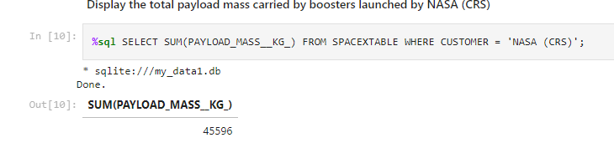
Total Payload Mass
45596,0 kg was carried by boosters launched by NASA

Slide 27
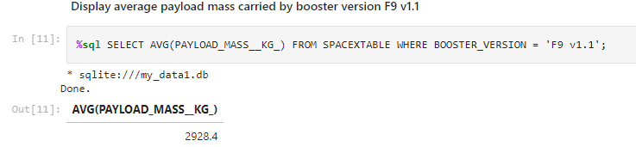
Average Payload Mass by F9 v1.1
2928,8 kg was carried by boosters launched by F9 v1.1

Slide 28
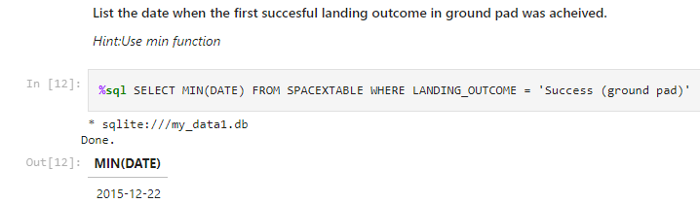
First Successful Ground Landing Date
Firs Successful Ground Landing Date:
2015-12-22

Slide 29
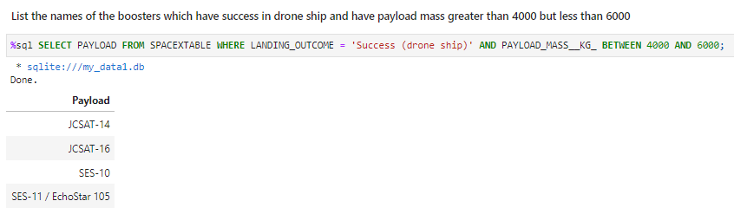
Successful Drone Ship Landing with Payload between 4000 and 6000
The boosters which have success in drone ship and have payload mass greater than 4000 but less than 6000

Slide 30
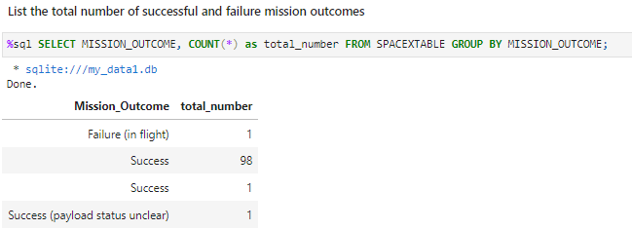
Total Number of Successful and Failure Mission Outcomes
List the total number of successful and failure mission outcomes

Slide 31
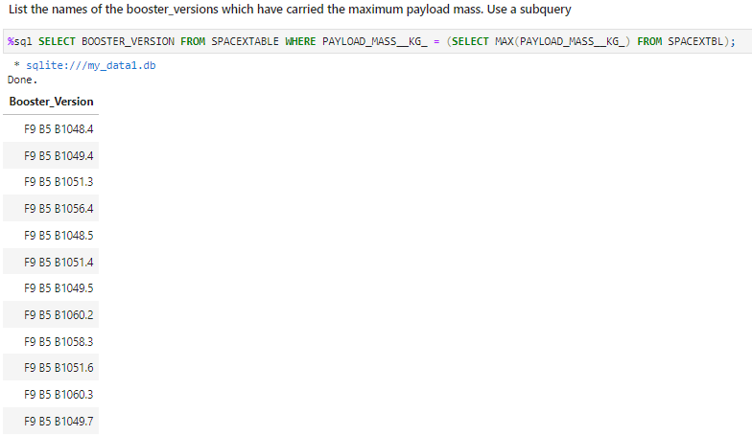
Boosters Carried Maximum Payload
List the names of the booster versions which have carried the maximum payload mass

Slide 32
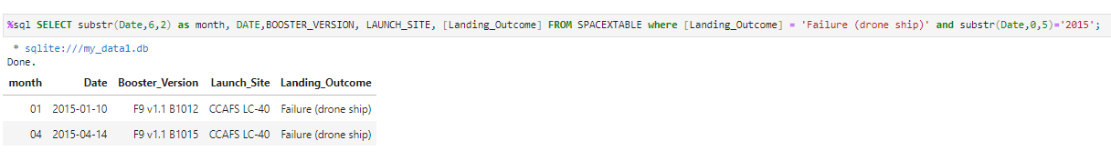
2015 Launch Records
List the records which will display the month names, failure landing_outcomes in drone ship ,booster versions, launch_site for the months in year 2015.

Slide 33
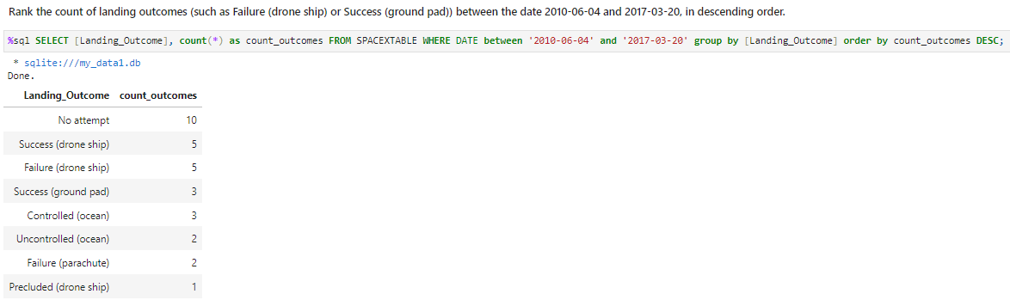
Rank Landing Outcomes Between 2010-06-04 and 2017-03-20
Rank the count of landing outcomes (such as Failure (drone ship) or Success (ground pad)) between the date 2010-06-04 and 2017-03-20, in descending order.

Slide 34

Section 3

Slide 35
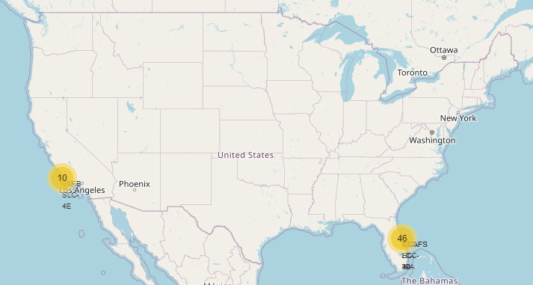
Launch Sites in US
Launch sites are located near bodies of water to provide a safe area for rocket stages to fall back to Earth
Launch sites are often located near the Equator for several strategic reasons that enhance the efficiency and effectiveness of space launches.

Slide 36
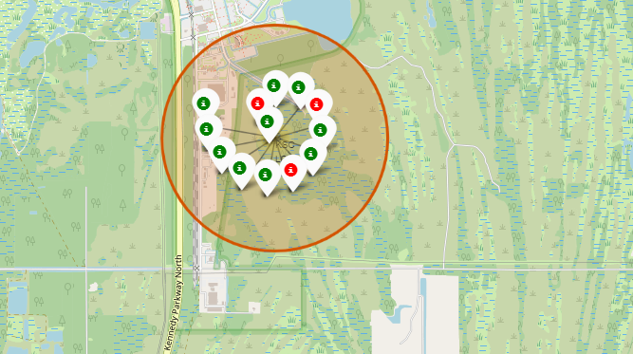
Launch Outcomes
KSC LC-39A with 10 success (green) and 3 fails (red) launches

Slide 37
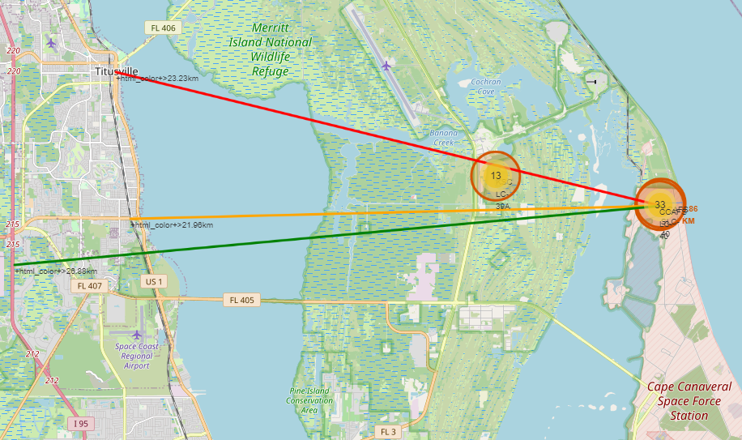
Distance to a closest city, railway, highway,
Launch sites are situated near railways, highways and coastlines to facilitate transport of rocket components, propellants and payloads.
The proximity to the coast allows for the safe discharge of spent rocket stages into the ocean, minimizing risks to inhabited areas.
Distancing launch sites from urban areas reduces the risks associated with launch failures, noise and intense vibrations.
The remote location also contributes to security, access control and compliance with environmental regulations and international agreements, ensuring the success of space missions and minimizing negative impacts.

Slide 38

Section 4

Slide 39
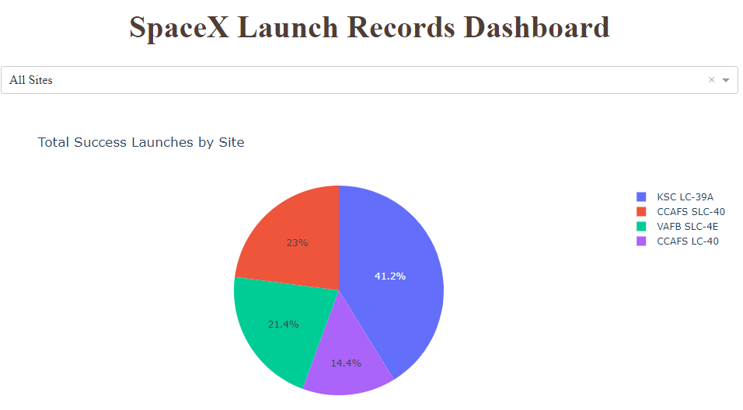
Total Success Launches by Site
KSC LC-39A é o site com a maior taxa de sucesso de lançamento

Slide 40
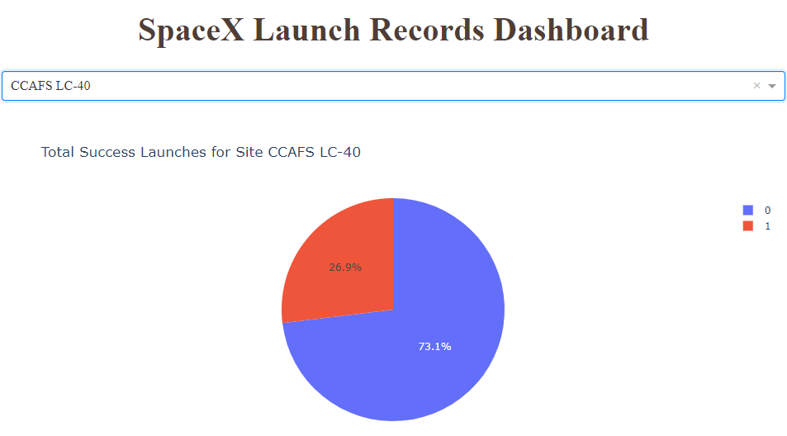
Total Success Launches for Site CCAFS LC-40
CCAFS LC-40 has a success rate of over 70%

Slide 41
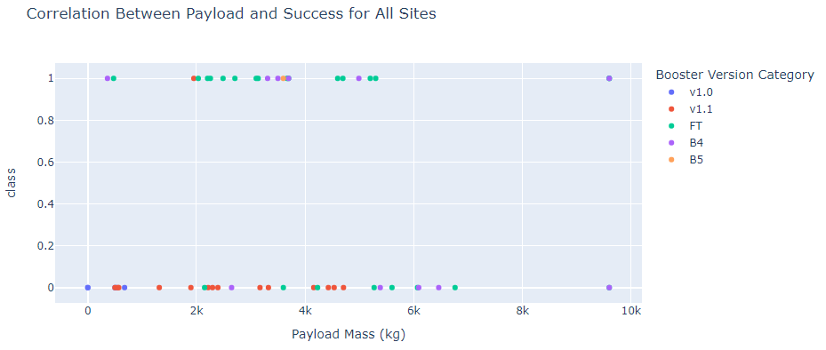
Correlation Between Payloads and Success for All Sites
Payloads between 2000 kg and 5000 kg have the highest success rate

Slide 42

Section 5

Slide 43
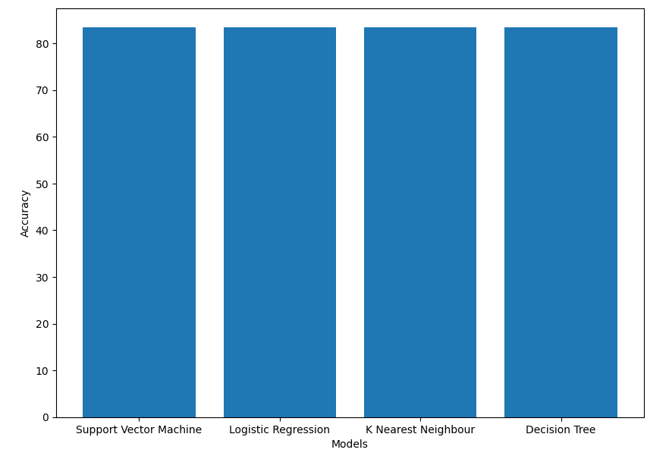
Classification Accuracy
All models performed the same on the test set, but in training the model that had the best accuracy was DecisionTree with 0.86

Slide 44
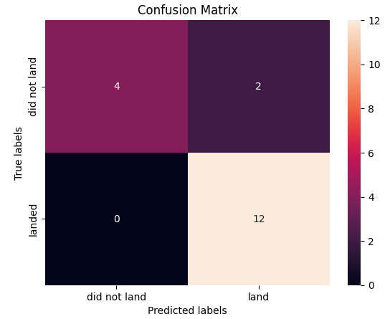
Confusion Matrix
With a confusion matrix visualizes and summarizes the performance of a classification algorithm.
True Negative: 4
False Positive: 2
False Negative: 0
True Positive: 12

Slide 45
Conclusions
The success launch rate increased over the time
Launch sites are located near bodies of water to provide a safe area for rocket stages to fall back to Earth
KSC LC-39A is the site with the highest launch success rating
It is possible to predict a successful launch with approximately 84% accuracy

Slide 46


